Slide 1
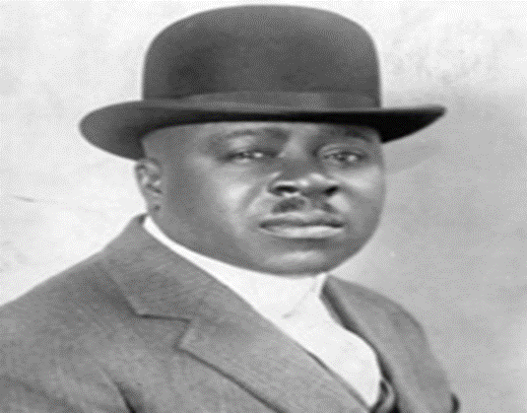
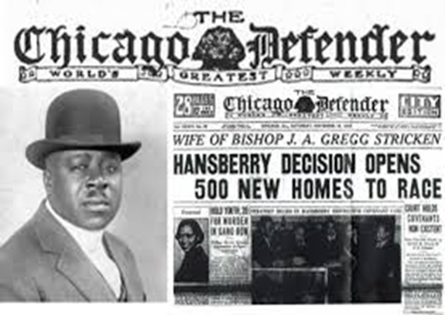
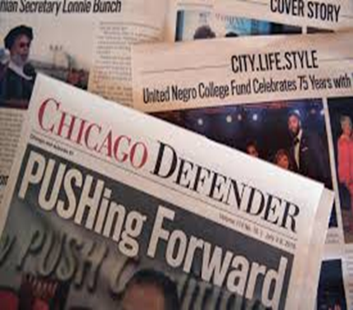
The Chicago Defender
Robert Sengstacke Abbott was also known as the Chicago defender was born in November, 4, 1868 in St Simons, Chicago, Illinois in the united states of America. He was a lawyer , newspaper publisher, and news editor.
He founded the newspaper the Chicago defender in the year 1905. the newspaper grew and had the highest circulation of any black owned newspaper in the country at that time

Slide 2
History of the Chicago Defender newspaper
Abbott acquired his printing knowledge at the Hampton institute before he proceeded to study law at the Kent college in the city of Chicago. He tried earning some living as a layer but he found it very hard. He then thought about changing his career.
The Chicago defender then realized that he might make greater success by battling white supremacy and achieve equality for the black people who faced oppression and discrimination.
At a tender age of 35 years, Abbott established The Chicago Defender newspaper from either the kitchen or dining room of his landlady’s home. The first 300 copies were printed using the knowledge he gained from learning the print trade and a small loan. Abbott went door-to-door throughout Chicago’s South Side selling the paper.
The Chicago Defender struggled to establish itself for several years but eventually found its footing. Initially, the paper was a weekly platform for expressing the concerns and voicing the issues of African Americans in Chicago.

Slide 3
History of the Chicago Defender newspaper continued
For decades The Chicago Defender was located at 34th Street and Indiana Avenue on Chicago's South Side. Locals called the neighborhood “Bronzeville.”
The newspaper’s offices sat alongside churches, businesses, jazz and blues clubs, boardinghouses, and private residences, ranging from "kitchenettes" in run-down tenements to mansions. Bronzeville was a dynamic and influential city within a city.
The Defender created distribution networks in northern urban centers like Harlem. In the South, however, white distributors refused to carry the paper.
The paper depended on an underground network of Pullman porters, who traveled south with copies of the Defender. The newspapers were then circulated hand to hand or read in local restaurants and barbershops. Through this ad-hoc distribution, hundreds of thousands of black southerners had access to the newspaper, which many came to see as a trusted guide

Slide 4
The Chicago defender fight for the rights of the black people
Robert Sengstacke Abbott founded the Bud Biliken parade and picnic in the year 1929, the parade has since then developed into a celebration for youth, education and –American life in Chicago.
The Chicago defender always advocated and pushed for job opportunities and social justices. The Chicago defender wanted the blacks to leave the segregated settlements.
He had a distribution network that was made up of African –American road porters. By 1925, they organized a union as the brotherhood of sleeping car porters.
The brotherhood of sleeping cars porters often sold and distributed papers on trains. The defender magazine circulation reached 50,000 by the year 1916.
Robert Sengstacke Abbott Defender magazine became the most popular magazine in the united states of America and was known as the Americas Black newspaper.
The Chicago defender magazine sales made Robert Sengstacke Abbott the first self made Black –American self made millionaire.

Slide 5
The Chicago defender fight for the rights of the black people continuation
The Chicago defender business expanded as many African –American's moved to the cities.
His magazine gave hopes to the oppressed people in the south. He wrote about stories of earlier migrants to the north.
He fought against social segregation, discrimination of blacks, prevention of Africa- Americans from voting, depilated African-Americans and other social injustices.
The Chicago defender wrote about how awful the living conditions were at the south and described the north as the place for justice and prosperity.
The magazine encouraged people to migrate to the north and also fight for their rights.

Slide 6
The Chicago defender fight for the rights of the black people continuation
The Chicago defender and fought for human rights and had his goals that were;
American race prejudice must be destroyed;
Opening up all trade unions to blacks as well as whites;
Representation in the President's Cabinet'
Hiring black engineers, firemen, and conductors on all American railroads, and to all jobs in government;
Gaining representation in all departments of the police forces over the entire United States;
Government schools giving preference to American citizens before foreigners;
Hiring black motormen and conductors on surface, elevated, and motor bus lines throughout America;
Federal legislation to abolish lynching; and
Full enfranchisement of all American citizens

Slide 7
The Chicago defender newspaper
The Chicago defender writer played a very big role in influencing the great migration of African- American from the rural south to the urban north by using strong, moralistic rhetoric in his editorial work and political cartoons.
His work promoted Chicago as a destination, and the advertisement of some successful African-American as inspiration for the blacks who were living in the south through his newspaper..
His editorial work exhibited in the newspaper the Chicago defender demanded equality of all races and also promoted the migration to the northern parts.
The Chicago defender newspaper would publish articles that exposed the southern crimes against the American black people in the south.
In his articles, he constantly published articles that described the lynching in the south, while giving vivid description of gore and the victims death.
At that period, the southern legislators were passing the new constitution and laws to disenfranchise most blacks and exclude them from the political system in the USA.

Slide 8
Distribution and critics of the newspaper
During those times legislatures dominated by the conservative white democrats established racial segregation and Jim crow.
His newspaper continuously criticized and openly criticized lynching violence on the white mobs who were actively involved, and this forced the readers of the newspaper to accept that these crimes were systematic and unremitting.
The newspaper's intense focus on these injustices implicitly laid the groundwork upon which Abbott would build his explicit critiques of society
His continued art work and political cartoons explicitly addressed the issue of race and advocated for the northern migration of the blacks.
He played a big role in influencing the migration and published the migration story at the front pages of his newspaper and this placed his newspaper as the primary influencer of these movements to the northern and western cities.

Slide 9
The Chicago defender influence
Due to his influence, there was a surge in migration from the southern to the western and the north cities. The migration was known as the great migration in which an estimated million people migrated form the rural southern in the beginning of the 20th century.
The newspaper used to promote Chicago as an attractive destination for the southern blacks and made Chicago a promised land that was full of abundant jobs.
His newspaper filled advertisement that were clearly aimed at enticing the southern blacks and the adverts called for massive number of workers wanted in factories.
The Defender was filled with advertisements for desirable commodities, beauty products and technological devices. Abbott's paper was the first black newspaper to incorporate a full entertainment section

Slide 10
The Chicago defender view on Chicago city
Chicago was portrayed as a lively city where blacks commonly went to the theaters, ate out at fancy restaurants, attended sports events, including "cheering for the American Black Giants, black America's favorite baseball team", and could dance all night in the hottest night clubs.
The Defender featured letters and poetry submitted by successful recent migrants; these writings "served as representative anecdotes, supplying readers with prototype examples ... that characterized the migration campaign“. To supplement these first-person accounts, Abbott often published small features on successful blacks in Chicago.
The well-known African American mentalist Princess Mysteria had from 1920 to her death in 1930 a weekly column on the Defender, called "Advise to the Wise and Otherwise

Slide 11
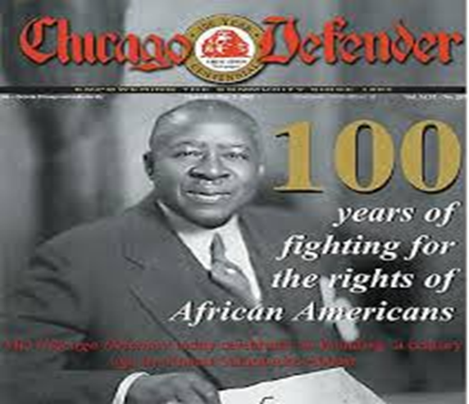
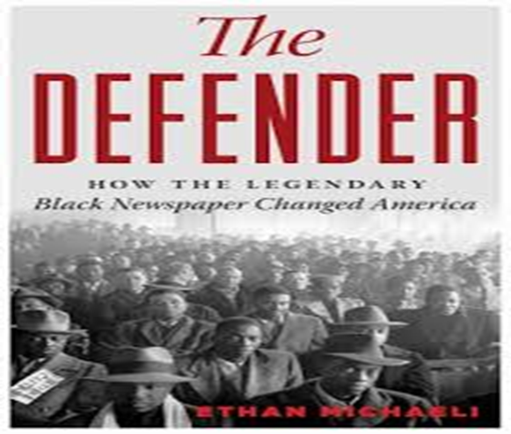
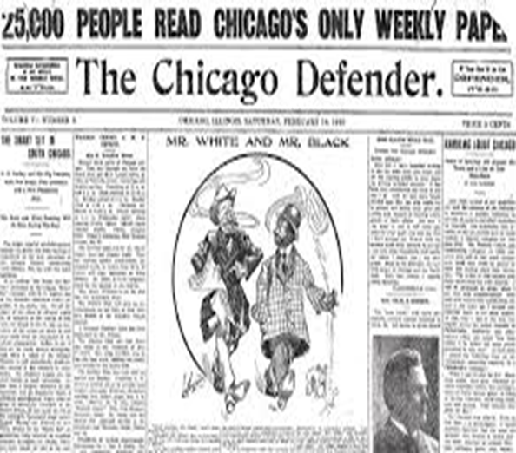
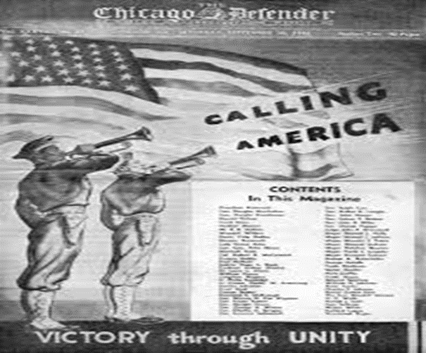
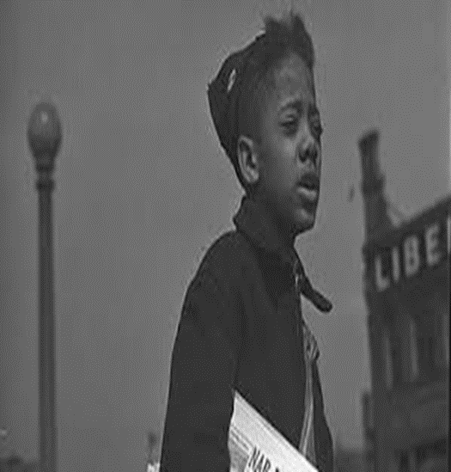
The Chicago defender images and video clip

Slide 12
The Chicago defender newspaper distribution network
The Defender created distribution networks in northern urban centers like Harlem. In the South, however, white distributors refused to carry the paper. The paper depended on an underground network of Pullman porters, who traveled south with copies of the Defender.
The newspapers were then circulated hand to hand or read in local restaurants and barbershops. Through this ad-hoc distribution, hundreds of thousands of black southerners had access to the newspaper, which many came to see as a trusted guide.
The Defender both shaped and responded to the Great Migration to Chicago. The migration unleashed new social, political, and religious movements, all of which found their way into the paper.
Channeling the energy of "the Black Metropolis," the Defender helped publicize the careers of influential Chicago residents, from a range of professions. This list included writers Richard Wright and Gwendolyn Brooks, musicians Louis Armstrong and Muddy Waters, and political leaders Archibald Carey and William Dawson.

Slide 13
The Chicago defender newspaper distribution network continuation
The Defender created distribution networks in northern urban centers like Harlem. In the South, however, white distributors refused to carry the paper.
The paper depended on an underground network of Pullman porters, who traveled south with copies of the Defender. The newspapers were then circulated hand to hand or read in local restaurants and barbershops.
Through this ad-hoc distribution, hundreds of thousands of black southerners had access to the newspaper, which many came to see as a trusted guide and a source of inspiration to many Africa- American.

Slide 14
The Chicago defender and fight for black military rights
These Chicago defender newspapers played a big role in promoting freedom and justice among black Americans including the black military who were involved in world war 1.
As the leader in this movement, the Chicago defender advocated for the fair and equal treatment of black servicemen fighting in World War II, urging that the ranks of the armed services be integrated.
The courageous efforts of black military units such as the 24th Infantry Regiment were viewed by the Defender and other black newspapers as a source of pride as well as a moment of opportunity.
While black Americans had participated in every major military conflict since the Revolutionary War, they were never accorded the same treatment as their white counterparts. Military units were segregated and black soldiers were often relegated to secondary or non‐​combat roles.

Slide 15
The Chicago defender and fight for black military rights and his demise
For years, the black press had championed the cause of integrating the armed forces. A crowning achievement came in 1948 when President Harry Truman issued Executive Order 9981, mandating the desegregation of all military branches.
Black papers reported on the mistreatment of black soldiers during the early years of World War I. Their support for popular demands for safety, equal rights, and the recognition of black soldiers who fought in Europe led the U.S. government to threaten to indict African American publishers for sedition.
However, Sengstacke, as the publisher of the Defender, stepped in and successfully negotiated a compromise with the Justice Department that protected the First Amendment rights of the black press.
The defender died on the year 1940 after suffering the Bright's disease and was buried in Chicago.

